Slide 1

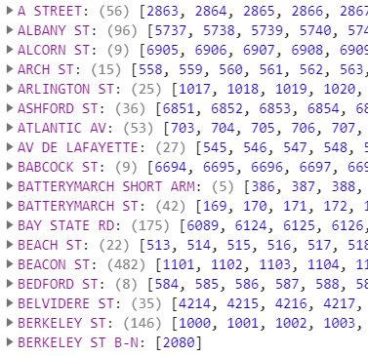

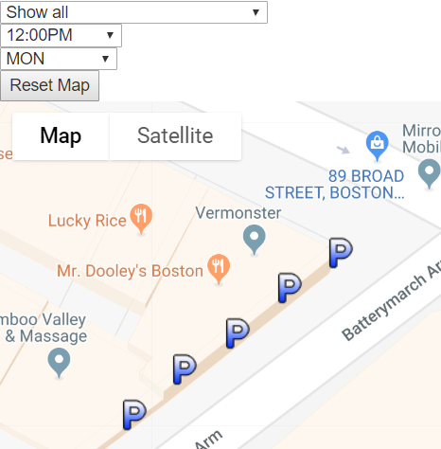
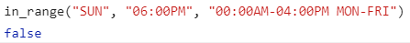
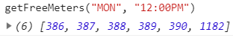
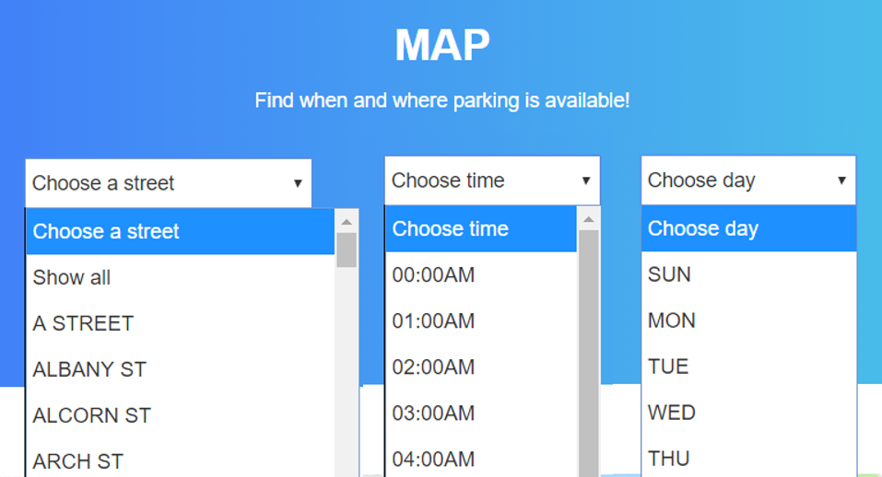
Boston, Big Data, and Web Technologies
Organizing Data
With a large database of 6955 parking meters in the city of Boston, grouping and filtering meters by the most relevant of 41 properties makes data digestible and patterns noticeable. For example, we can sort meters by street location, which is extremely useful for sectioning and displaying groups of markers for the map. Entries with missing or incorrectly formatted information are discarded.
ABSTRACT
EXTRACT DATA
INTERACTIVE MAP
Parsing Data
EXPLAIN DATA
Free parking times in the database are given as 19-23 character length strings, which isn’t an naturally useful form for data extraction.
A parsing function extracts start and end times and days and performs a series of string comparisons to provide the user with a list of all free parking meters on a given day and time.
Clev
I worked on transforming the raw parking data into more easily useable forms and groups. I also wrote the functions that provide a user with free parking meters at any given time of day.
Figuring out how to manipulate one provided representation of data, most notably in the case of the free parking time strings, into a representation that is easier for functions and comparisons, was time-consuming and took some trial and error because of all the edge cases to consider.
Additionally, I created the selection menus for street, time, and day, where the user inputs and specifies the parking situation they are interested in.
My work for this project involved gaining more familiarity with JavaScript objects, data structures, and functions, and how they combine with the display of HTML elements.
User Interface
The parking meter map on the website allows the user to select from 189 streets, 24 hours, and 7 days, allowing for users to search quickly over a broad geographic and easily find robust parking information for every single hour of the day over the entire week. Once these fields are selected, the map zooms to that particular street. Then, the parking meters on that street that are free on that given day at the given time are marked on the map.

Slide 2
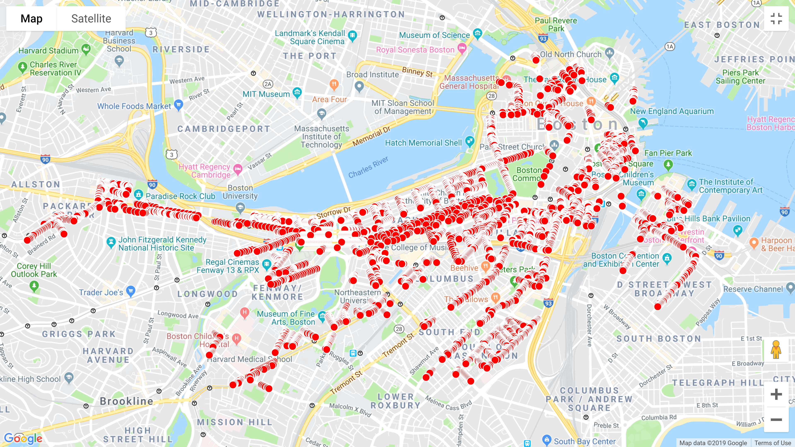

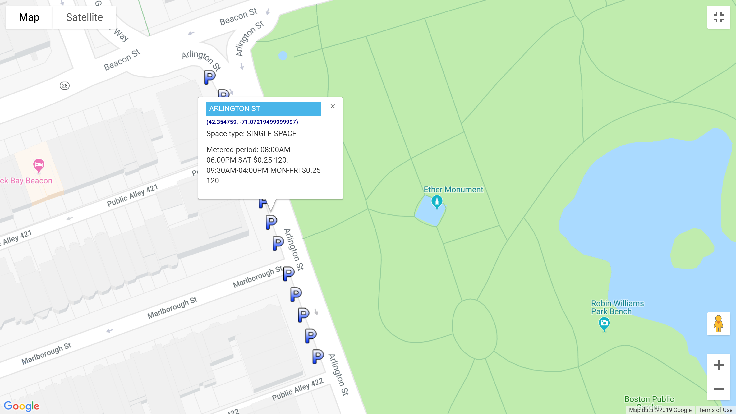
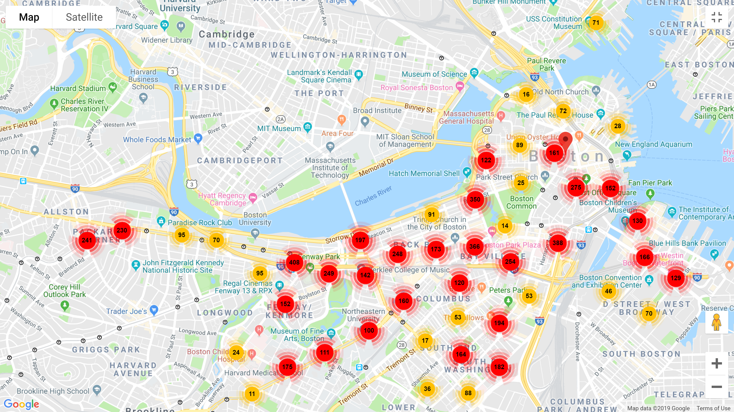

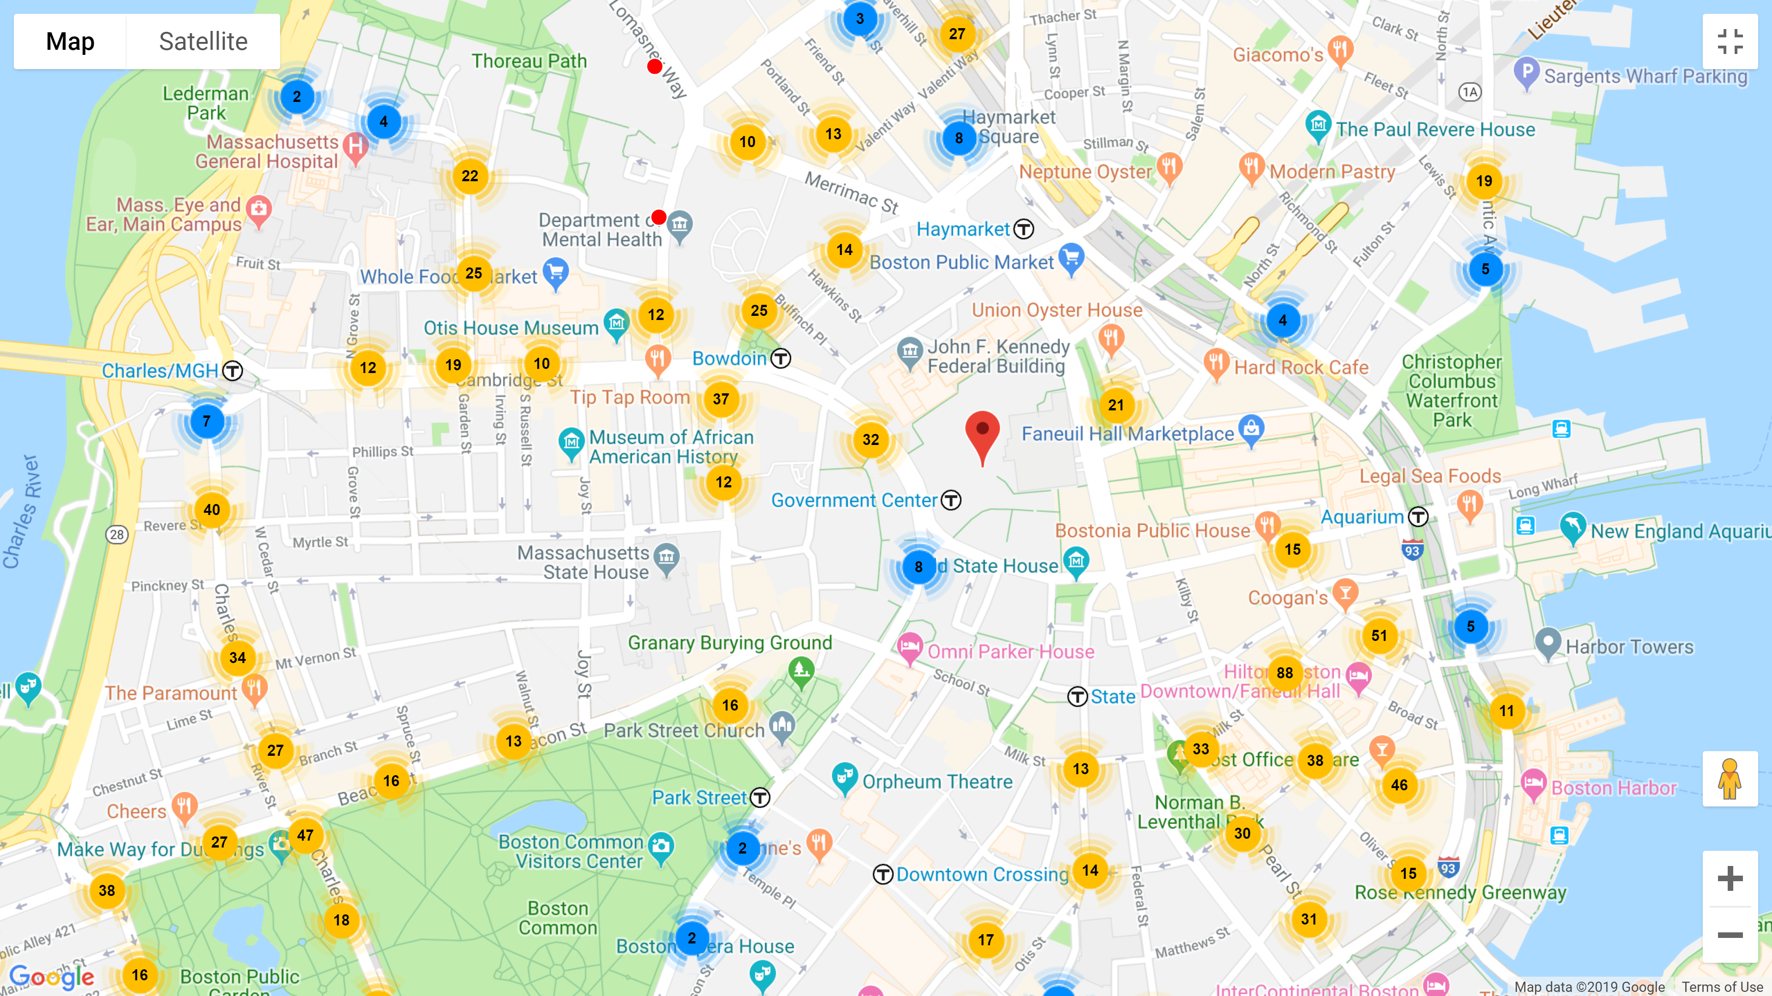
Boston, Big Data, and Web Technologies
Google Maps API
Google Maps API (Application Platform Interface) is a development tool that allow developers to customize map visualization and interaction. As the project centers on plotting coordinates of parking meters, the main tools utilized are creating markers onto the map, integrating existing markers under clusters, and showing information about each parking meter for users’ readability.
ABSTRACT
EXTRACT DATA
InfoWindow
INTERACTIVE MAP
To allow users to know more about a parking space other than the time that it is free, a pop-up window will appear upon clicking the marker. Useful information such as the space type and metered period will help users have an easier time choosing the right parking space.
Big Data Problems
Initial plotting of about 7000 parking spaces created tremendous lagging of nearly 7 seconds for each movement. The overlapping markers interfered with users’ understanding of the actual number of available parking in any particular region.
EXPLAIN DATA
Uyen Nguyen is a first-year undergraduate at Massachusetts Institute of Technology(MIT), aspiring to major in Electrical Engineering and Computer Science. She developed the Google maps platform for this project. Currently, she is also programming for the MIT Solar Electric Vehicle Team. She is a proud and active veteran of FIRST Robotics and VEX Robotics.
Marker Clustering
Grouping markers into clusters helps computers keep better track of all the markers’ location by assigning markers to specific regions. Depending on the zoom level, the clusters will merge or break up into other clusters to represent the general region. The number label on each marker cluster tells users the number of available parking of a particular area.

Slide 3
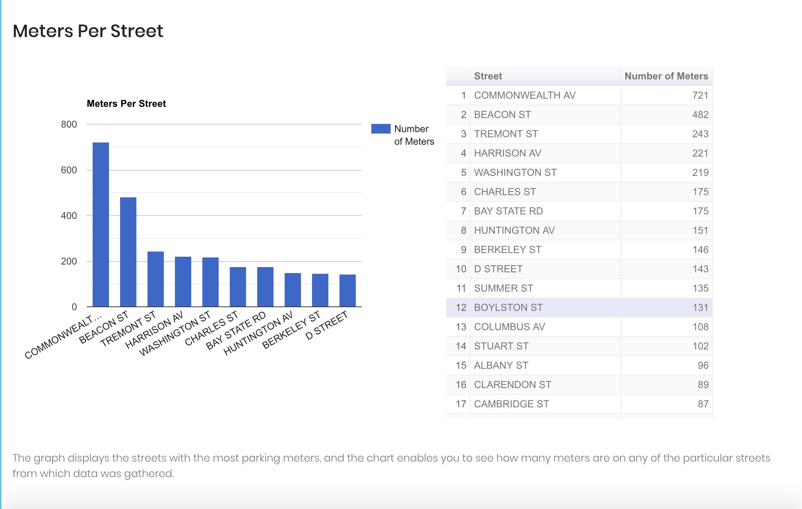
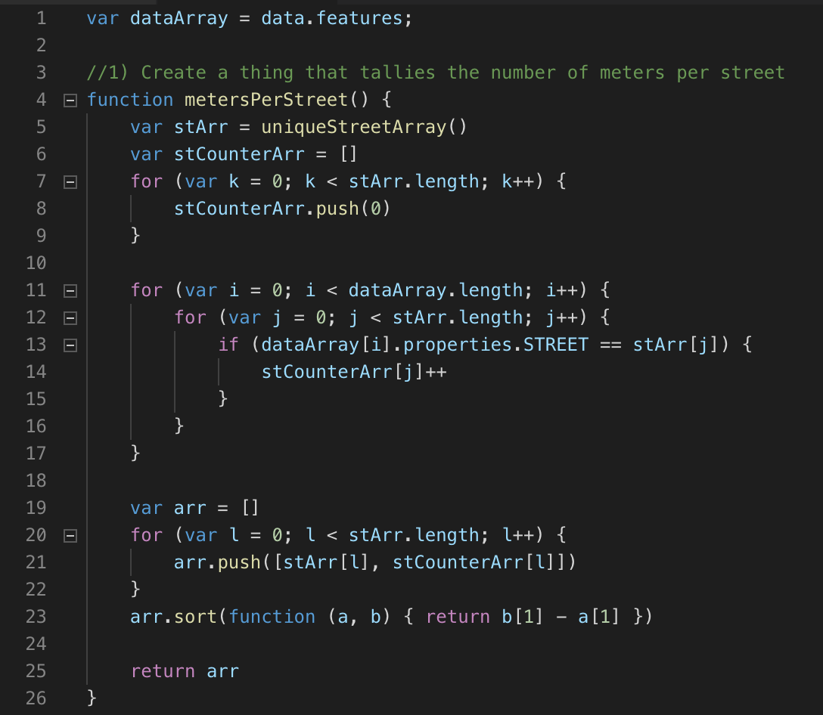
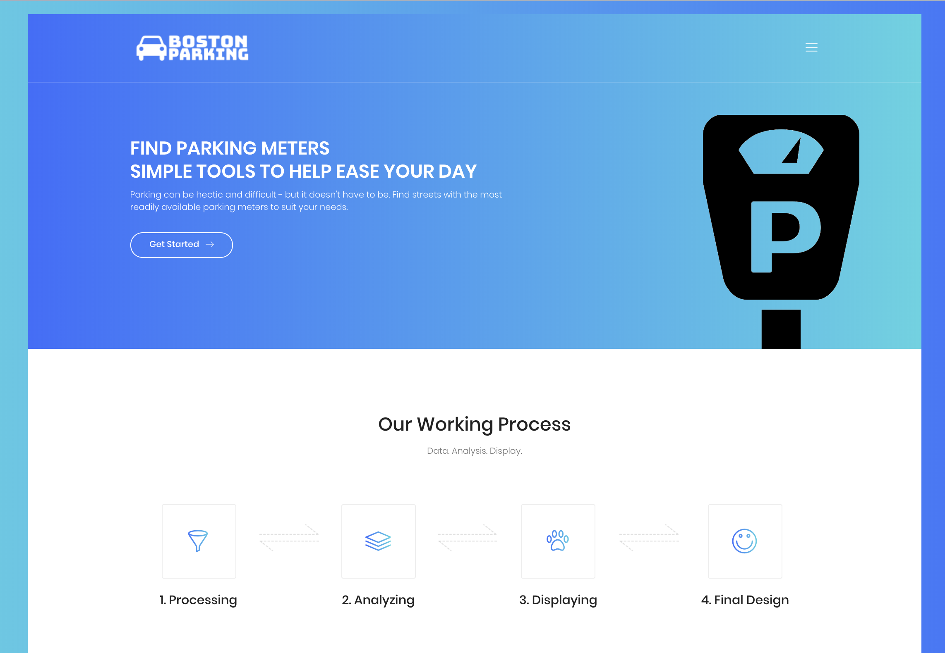
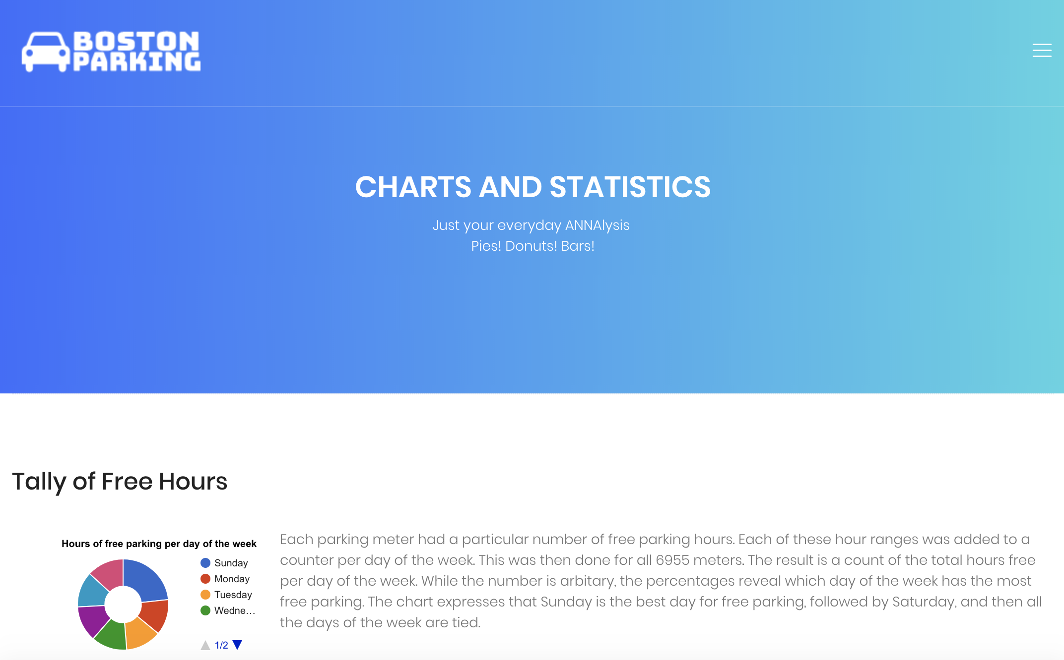
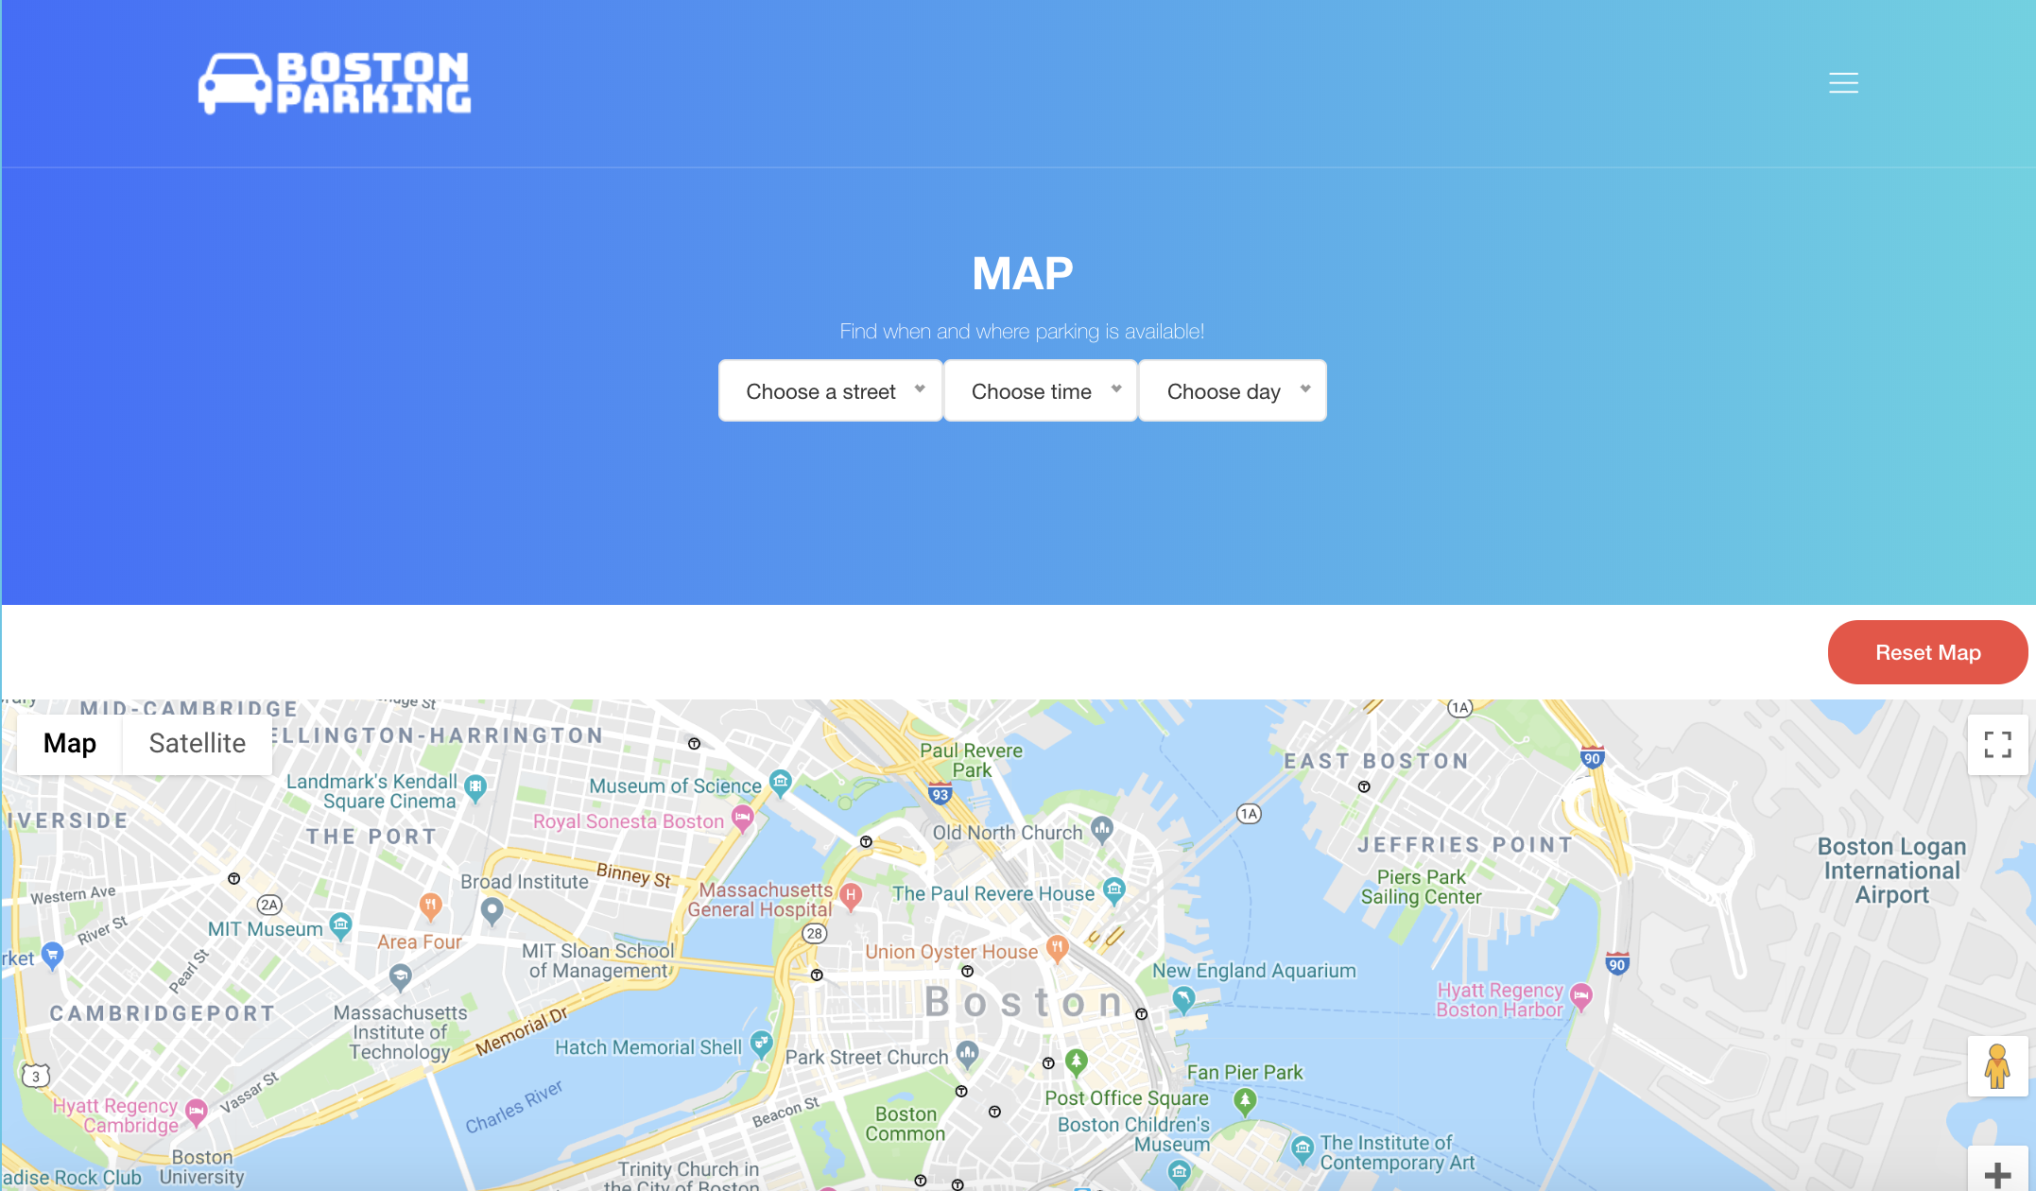
Boston, Big Data, and Web Technologies
Creation of Useful Data
The raw parking data was a JavaScript file that keyed attributes of parking meters in a large list. However, this data was meaningless until extracted. As such, our team coded in JavaScript to extract meaning full statistics such as counts, averages, and modes. Not all the data was entirely useful to a user, so the team used their discretion to select which of their created numbers and charts would be most essential.
ABSTRACT
EXTRACT DATA
Finished Website
INTERACTIVE MAP
After all of the data was incorporated into the main website, it had to be manipulated for aesthetics. Hence, html and css were used to adapt various features and make them more visually stimulating.
Manipulation of a Template
After downloading a template in the form of a collection of html, CSS, and SCSS files, it had to be manipulated to suit to the team’s needs. Each page on the website required generation of a new html file and adaptation of the code to change the text and appearance.
EXPLAIN DATA
Anna
I worked on much of the front end development of the website: the HTML code. However, I first gained insight into JavaScript syntax by sorting through the data. I made use of counters and for loops to produce useful stats such as the number of streets on which there was parking. From there, it was my job to create a html page with google charts of some of the key findings. This page was not the final product. The final product was the website. As such, much of my work involved taking code and incorporating aspects thereof into a new html using direct references, some direct copying, and other methods. The result was a template overridden with our data. The tail-end of the project was a time consuming process involving the design of the website, which required understanding the CSS.
Incorporation of Map
After the charts, statistics, and introductory pages were included, the portion of the team working on the creation of the main feature of the website – the interactive map - uploaded their work to GitHub and the Map was tastefully incorporated into the website framework.

